Slide 1
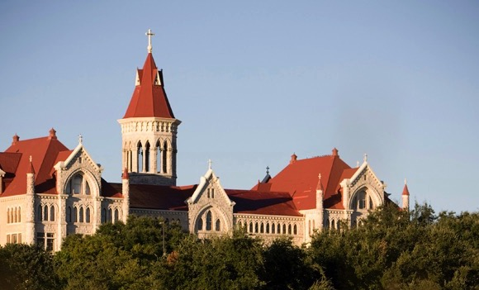
Keeping Austin Weird
A Semesters Trek
St Edwards University
Alexandra Robinson alexan@stedwards.edu

Slide 2
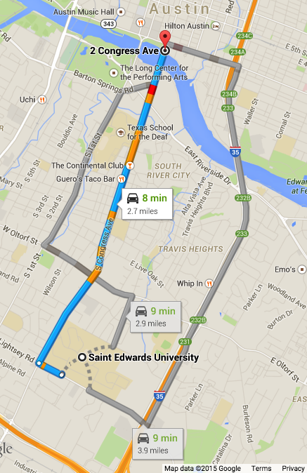
VISU1311, Visual Studies I
New course for newly formed Visual Studies Department (Art, Graphic Design, Photocommunications)
Team taught course: art and photo
Serves digital component approached from a conceptual framework.
Students were limited to a 2.7 mile geographic location which also happens to be the most touristy place with destinations like The Continental Club, and the I love you sign. This strip could be traversed by:
walking
biking
driving

Slide 3
VISU 1311, Visual Studies I
Comprised of 3 projects with a final project.
Three major themes: Gestalt, Harmony and Sequence.
Watch it/Read it/Listen to it
Technical lectures: LightRoom, Photoshop, Scanning, InDesign
Personal Blog reflections/ Class Blog

Slide 4
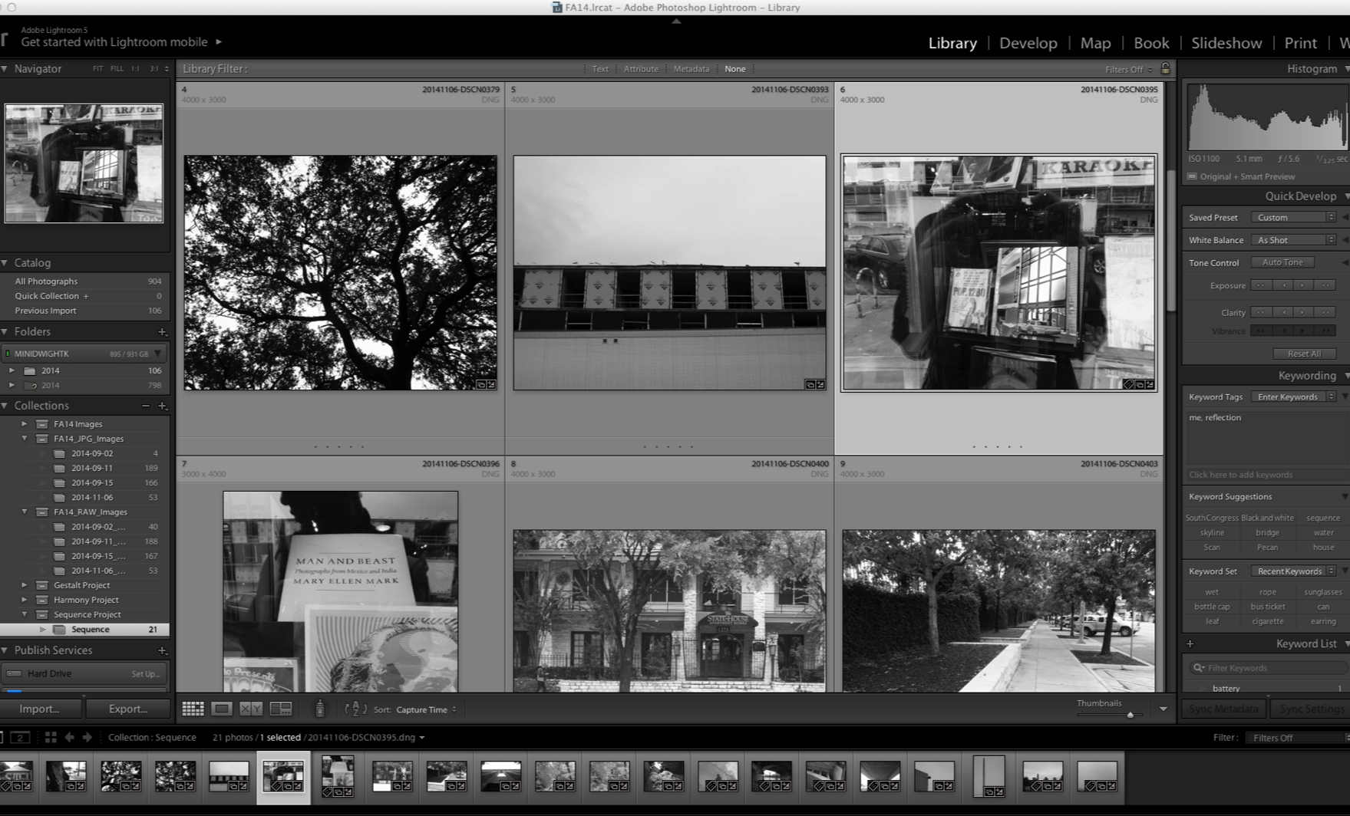
Students would show evidence of work through screen captures in Lightroom

Slide 5
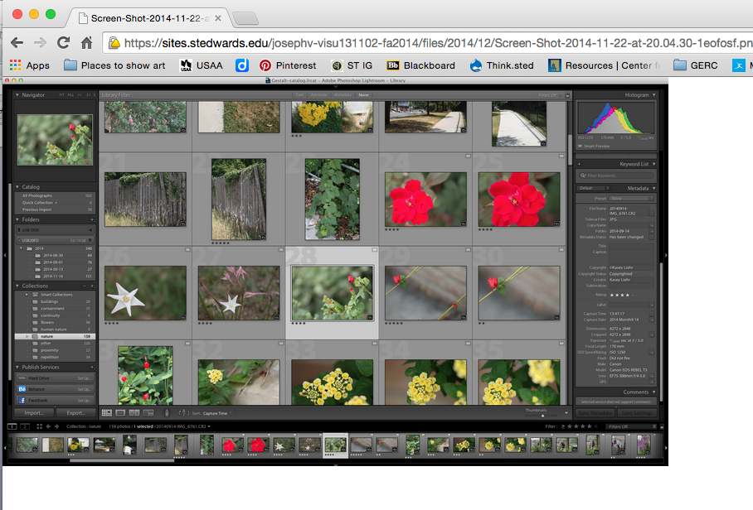

Slide 6
Gestalt
How do you take an image?
Objectives:
To apply gestalt principles to image(s)
To post reflection(s) and images to Wordpress blog
To post final collection of images to Wordpress blog
To digitally process images using Lightroom (Bridge)
Because all course sections are visiting the same location, be mindful of your point of view as you apply it and answer the question. Be prepared to be flexible.

Slide 7
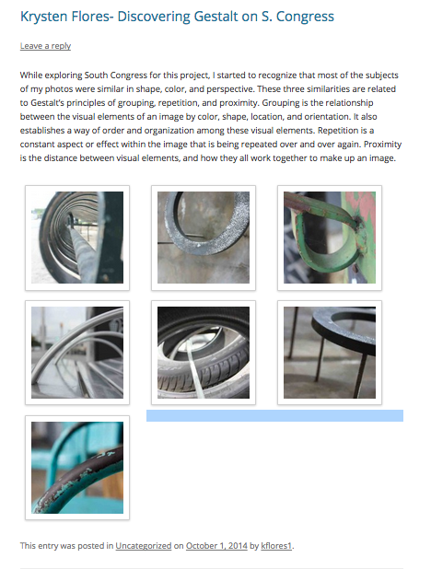

Slide 8
“Rather than noticing the buildings themselves, I become captivated by the play of light, shadow, and the sense of depth which the reflections embodied, along with the repetition of shapes created by the windows themselves. As I began to take photographs, I also became aware of the barriers created by different reflections overlapping at once and the way their corresponding lines and shapes blend together.”
–Sabrina Rohwer, student

Slide 9
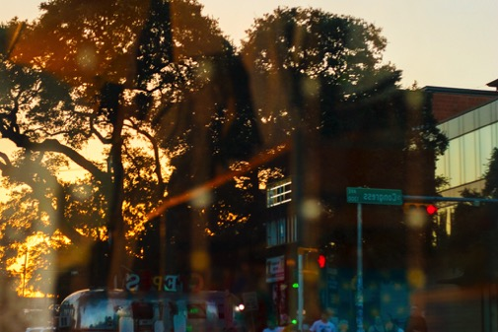
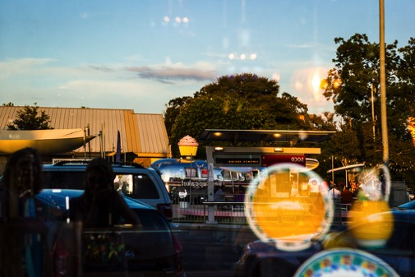
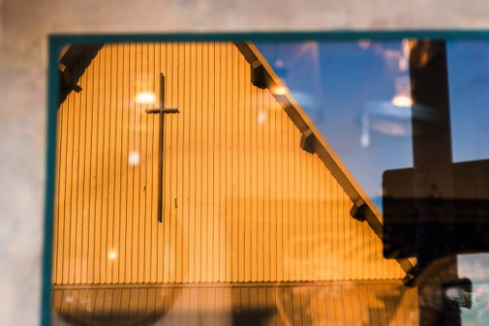
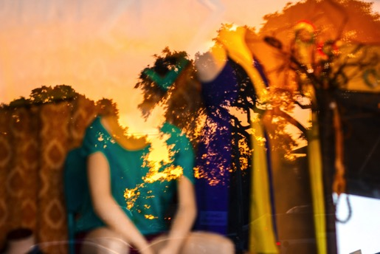
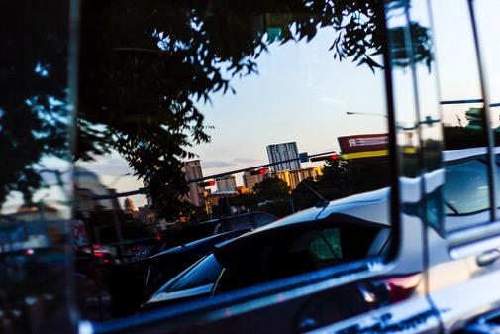
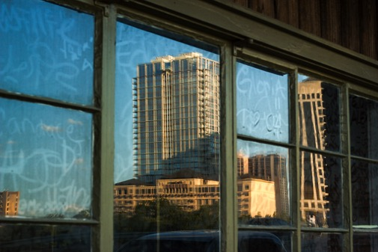
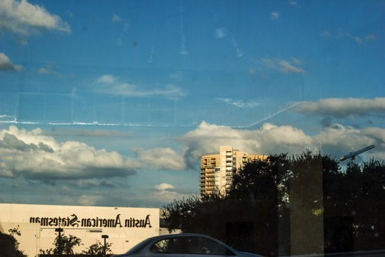
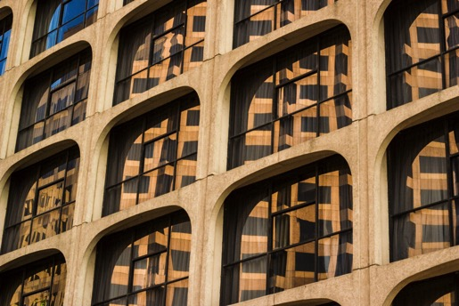
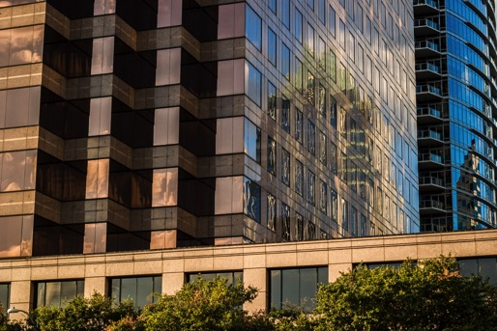
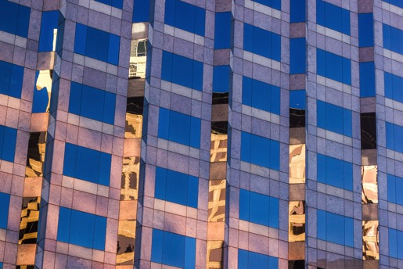
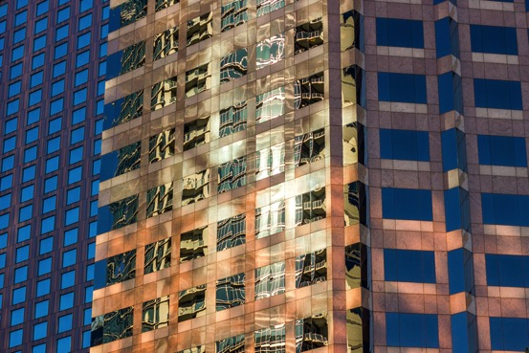
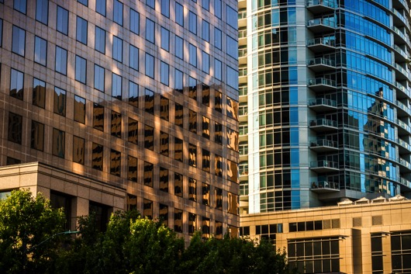

Slide 10
Watch it, Read it, Listen to it
What is Design, Hara Kenya
High Concept, High Touch, Daniel Pink
Photography, Flusser
On Creativity, Amy Tan
Dan Brackage, Stellar
Tunnel 57 (99 Percent Invisible)

Slide 11
“Upon listening to Tunnel 57 I was surprised I hadn’t heard of this sooner. I asked myself why we hadn’t learned about things like this in our history class. I also asked myself why we were listening to it. This is a visual studies class why were we listening to a radio show about men who dug a tunnel underneath a wall? Was I supposed to take the radio show as an art piece or the tunnel as an art piece? I didn’t know..”
–Hailey Johnson
writing about Tunnel 57, episode 104, 99 Percent Invisible

Slide 12
Harmony
How do you make an image?
Objectives:
Create imagery that uses harmony as the primary concept in joining
imagery using the process of collage and assemblage. (create
hierarchy)
Create 5 collages: 3 2D and 2 3D
Apply scanning options for found objects
Generate collages using hand tools and adhesives and a variety of paper.

Slide 13
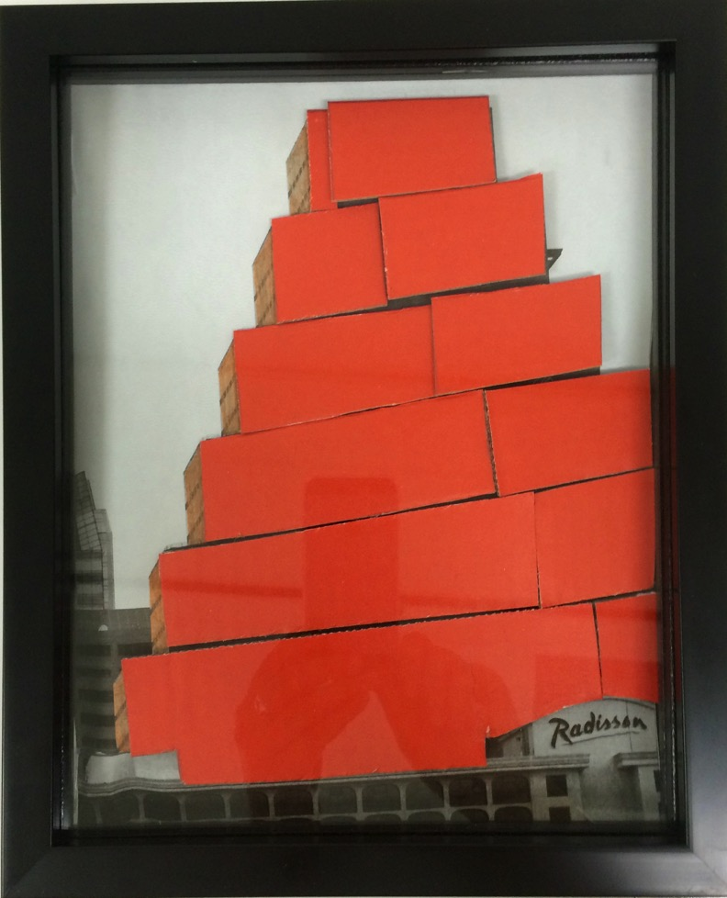
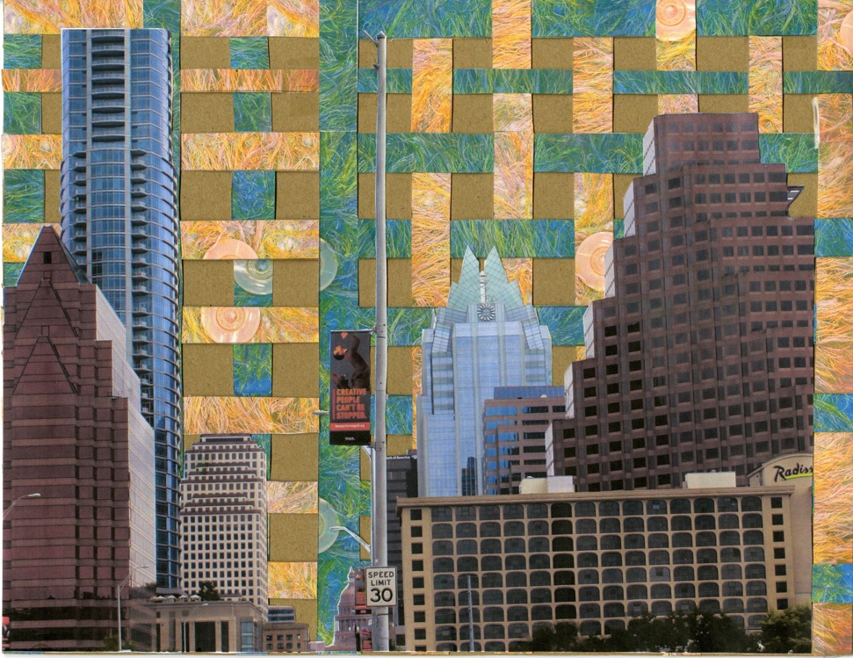

Slide 15
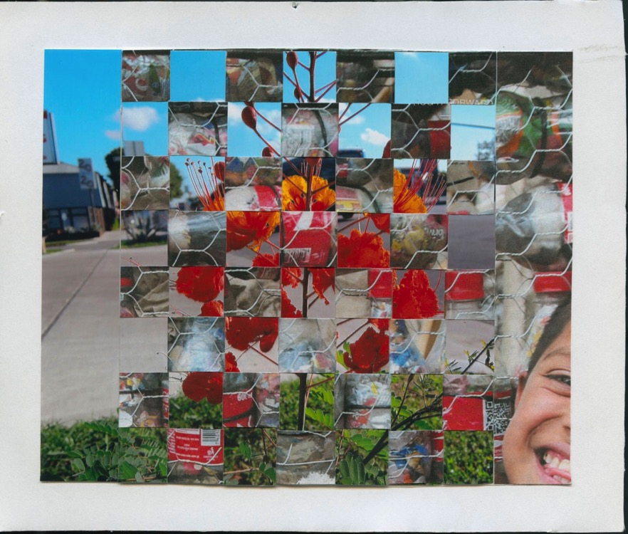
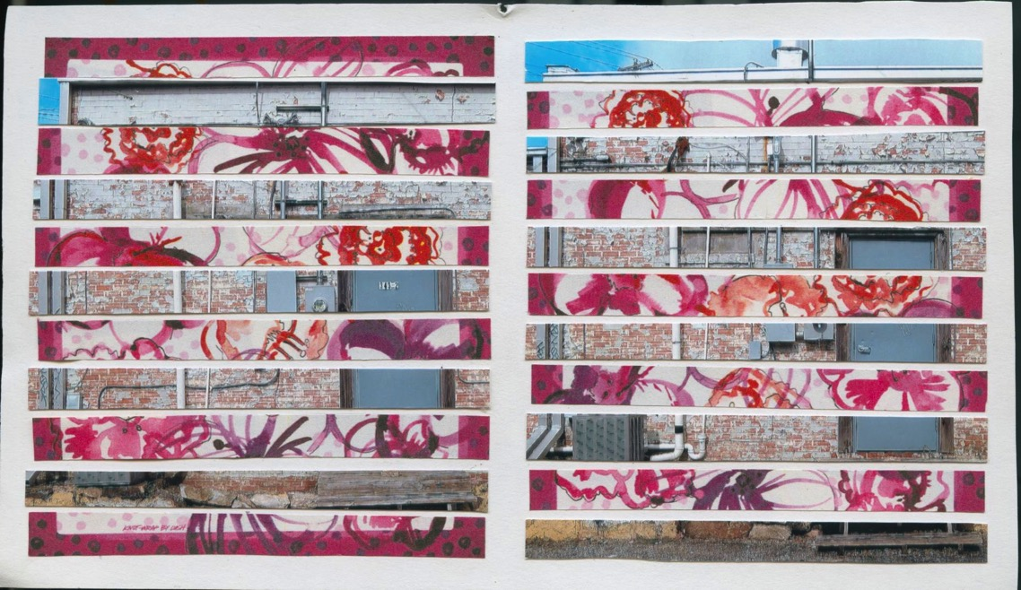

Slide 16
Sequence
How does an image become a story?
Objectives:
Create a 10 page book + cover and back + end paper/fly leaf
1 page that folds up
1 page that folds out to the right
1 page that has cut-out(s)
Create a narrative (non-narrative) using only imagery and text.
Apply the concept of sequence to a series of images
Print and bind book using spiral binding

Slide 17
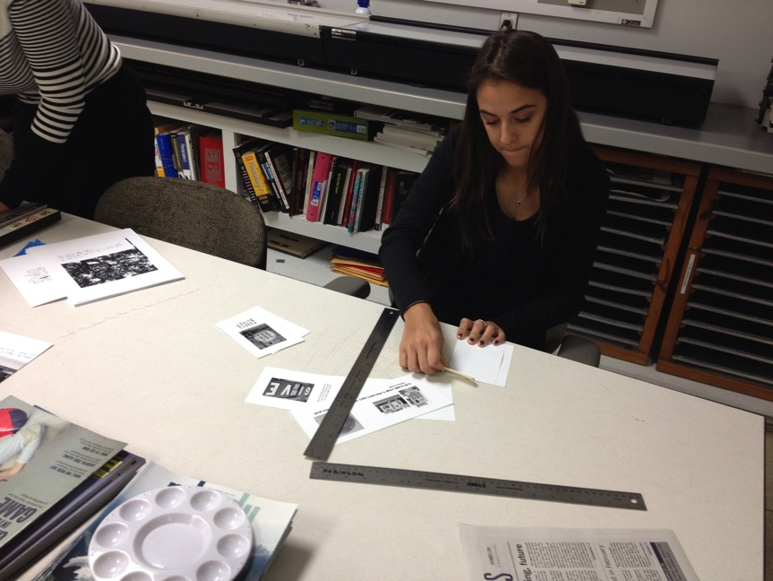
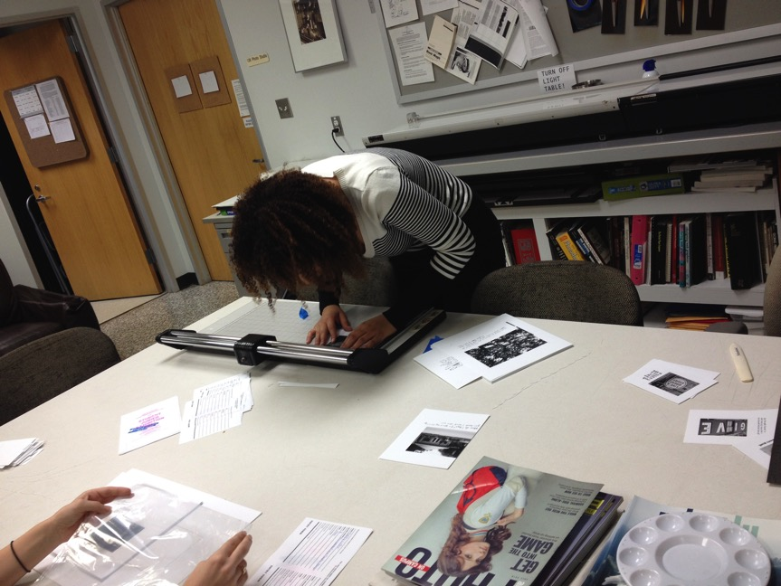

Slide 18
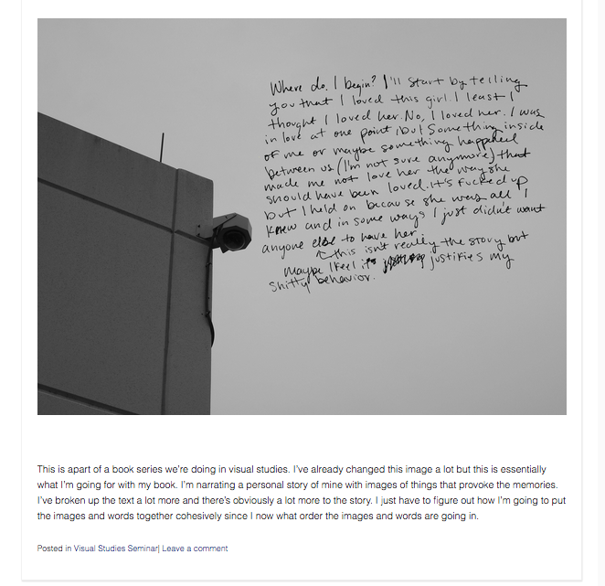

Slide 19
Watch it, Read it, Listen to it
Memento, film
Beyond Time, Radio Lab
Straight Outta Chevy Chase, Radio Lab
David Blane: How I held my breath for 17 minutes, TedTalk
The Way Things Go, video

Slide 20
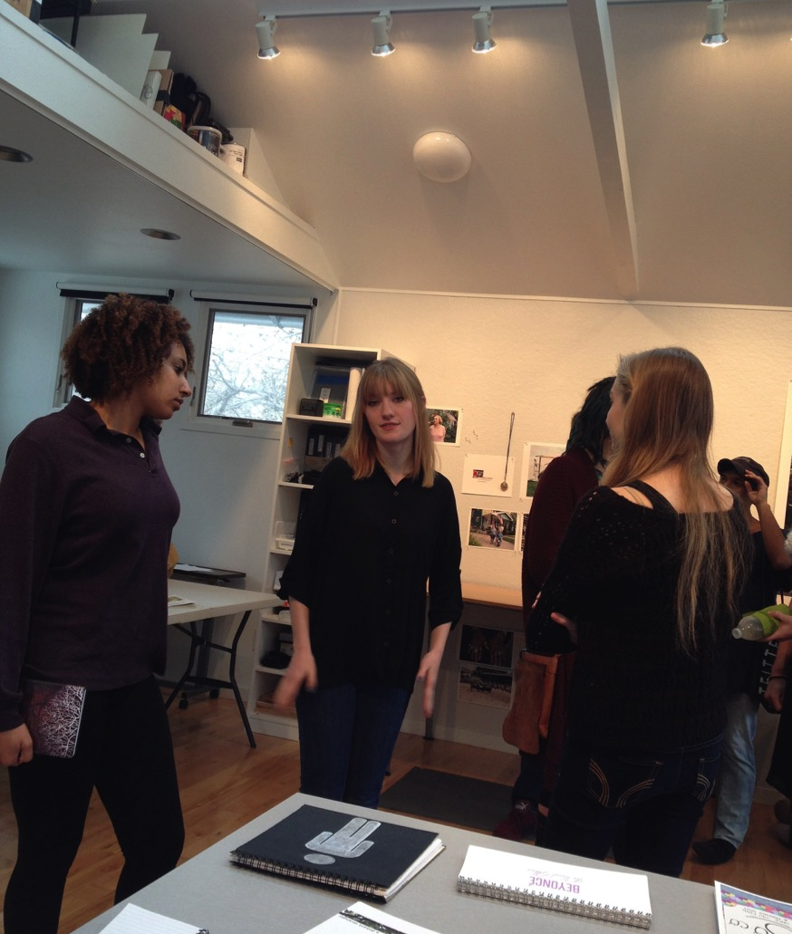
The evolution of Visual Studies I
more daily checks of software usage.
reinforce soft or working critiques
rework Harmony project
facilitate students preparedness for critique in the first semester.
4 projects?
additional community building project: like a projection night.

